Slide 1

Russian Aspect in Context
Laura A. Janda
UiT The Arctic University of Norway
Robert J. Reynolds
Brigham Young University

Slide 2
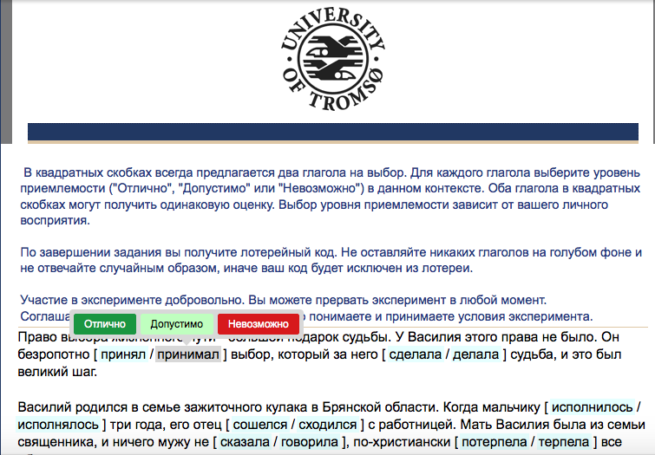


Experimental Approach to Russian Aspect
How do native speakers of Russian react to aspectual choices in extended authentic context?
To what extent is the choice of perfective vs. imperfective determined by context?
To what extent is the choice open to construal?
Do native speakers differ in their choices?
What factors are at play?
How can we use this information to improve instruction?

Slide 3
Overview
What motivated this experiment
Design of experiment
Results
Conclusions

Slide 4
What motivated this experiment
Certain lexical “triggers” are known to determine aspect
BUT: How often are these triggers available?
In other words, what percentage of verbs appear in collocation with triggers?
 | Adverbials as triggers | Verbs as triggers
Perfective | nakonec ‘finally’, vnezapno ‘suddenly’, srazu ‘immediately’, čut’ ne ‘nearly’, vdrug ‘suddenly’, uže ‘already’, neožidanno ‘unexpectedly’, sovsem ‘completely’, za tri časa ‘in three hours’… | zabyt’ ‘forget’, ostat’sja ‘remain’, rešit’ ‘decide’, udat’sja ‘succeed’, uspet’ ‘succeed’, spešit’ ‘hurry’…
Imperfective | vsegda ‘always’, často ‘often’, inogda ‘sometimes’, poka ‘while’, postojanno ‘continually’, obyčno ‘usually’, dolgo ‘for a long time’, každyj den’ ‘every day’, vse vremja ‘all the time’, tri časa ‘for three hours’… categorical negation: ne nado ‘should not’, ne stoit ‘not worth’, ne razrešaetsja ‘not allowed’… | Phasal verbs: stat’ ‘start’, načat’/načinat’ ‘begin’, prodolžit’/prodolžat’ ‘continue’, končit’/končat’ ‘stop’ Verbs of motion: pojti ‘go’, etc. Others: učit’sja ‘learn’, umet’ ‘know how’, ljubit’ ‘love’…

Slide 5

What motivated this experiment
Only 2 percent of verbs appear in collocation with triggers
Are there other unknown triggers?
How can we find out where aspect choice is obligatory and where it is variable?
 | Adverbials as triggers | Verbs as triggers
Perfective | nakonec ‘finally’, vnezapno ‘suddenly’, srazu ‘immediately’, čut’ ne ‘nearly’, vdrug ‘suddenly’, uže ‘already’, neožidanno ‘unexpectedly’, sovsem ‘completely’, za tri časa ‘in three hours’… | zabyt’ ‘forget’, ostat’sja ‘remain’, rešit’ ‘decide’, udat’sja ‘succeed’, uspet’ ‘succeed’, spešit’ ‘hurry’…
Imperfective | vsegda ‘always’, často ‘often’, inogda ‘sometimes’, poka ‘while’, postojanno ‘continually’, obyčno ‘usually’, dolgo ‘for a long time’, každyj den’ ‘every day’, vse vremja ‘all the time’, tri časa ‘for three hours’… categorical negation: ne nado ‘should not’, ne stoit ‘not worth’, ne razrešaetsja ‘not allowed’… | Phasal verbs: stat’ ‘start’, načat’/načinat’ ‘begin’, prodolžit’/prodolžat’ ‘continue’, končit’/končat’ ‘stop’ Verbs of motion: pojti ‘go’, etc. Others: učit’sja ‘learn’, umet’ ‘know how’, ljubit’ ‘love’…

Slide 6
How do native speakers of Russian react to aspectual choices in extended authentic context?
We conducted an experiment with over 500 native speakers and their reactions to aspectual choices for verbs in extended authentic contexts (1100-1600 words) representing various genres
For each verb where it was morphologically possible to form both a Perfective and an Imperfective form, participants rated both the original form and the corresponding form of the opposite aspect as “Impossible” = 0, “Acceptable” = 1, or “Excellent” = 2

Slide 7
Stimuli and Participants
Genre | Abbreviated Title | Words | Items (pairs) | Participants
Fiction | Beetle | 1459 | 300 (150) | 83
Journalistic Prose | Summit | 1116 | 166 (83) | 84
Scientific-Technical Prose | Phages | 1558 | 198 (99) | 72
Spoken Narration | Yellow Sign | 1275 | 160 (80) | 99
Guided Spoken Narration | MSLU | 1617 | 278 (139) | 78
Radio Interview | Ivan D. | 1468 | 244 (122) | 85
Totals |  |  | 1346 (673) | 501
Stimuli were chosen based on criteria of Authenticity, Genre Balance, Length, Density of Test Items, and Appropriateness
Participants were recruited over the Internet and randomly assigned to stimuli

Slide 8
Number of Test Item Pairs for Each Combination of Aspect and Subparadigm
 | Perfective | Imperfective | Total
Past | 298 | 134 | 432
Future | 50 | 7 | 57
Infinitive | 104 | 60 | 164
Imperative | 10 | 10 | 20
Total | 462 | 211 | 673
Verb forms excluded: Present tense, forms of быть, gerunds and participles, bi-aspectual verbs (e.g. родиться, реализовать), other verbs not paired for aspect, such as –ся passives (e.g. предназначатъся), and стать in the phasal meaning ‘begin’

Slide 9
Participants were NOT told what the original aspect was
Sample text as presented to participants:
Право выбора жизненного пути -- большой подарок судьбы. У Василия этого права не было. Он безропотно [ принял / принимал ] выбор, который за него [ сделала / делала ] судьба, и это был великий шаг.
Participants were asked to rate BOTH the Perfective and the Imperfective verb forms

Slide 10
What our experiment looked like:

Slide 11
Results
Distribution of responses
81% of items received categorical responses, confirming that the original aspect was much preferred over the non-original aspect: here aspect is HIGHLY redundant
17% of items received similar ratings for both original and non-original aspect: here aspect is HIGHLY open to construal
Native speakers react very differently to original vs. non-original aspect in terms of consistency – responses for non-original aspect are much LESS consistent

Slide 12
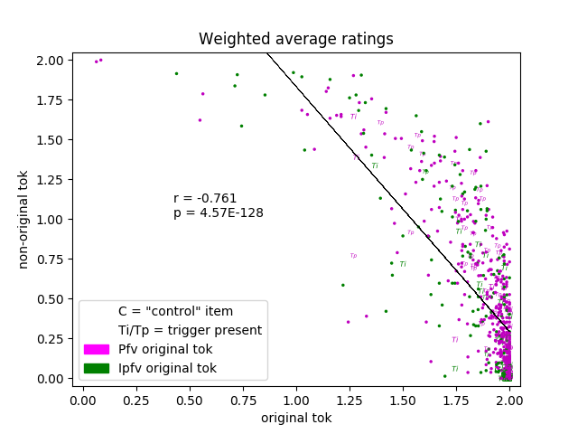

Slide 13
81% of the data is here.
Speakers reliably recover the original aspect.
Redundancy is HIGH.
Saliency of construal is LOW.

Slide 14
Examples of test items where redundancy of aspect is HIGH and construal is LOW
В восемь лет мальчик [ сбежал / сбегал ] из дома.
Богомольная женщина никогда не [ обругала / ругала ] его, но…
 | Impossible = 0 | Acceptable = 1 | Excellent = 2 | Average
Perfective сбежал (original aspect) | 0 | 0 | 82 | 2.0
Imperfective сбегал (non-original aspect) | 68 | 12 | 2 | 0.195
Perfective обругала (non-original aspect) | 79 | 3 | 0 | 0.037
Imperfective ругала (original aspect) | 0 | 0 | 82 | 2.0

Slide 15
17% of the data is here.
Speakers accept both aspects.
Redundancy is LOW.
Saliency of construal is HIGH.

Slide 16
Examples of test items where redundancy of aspect is LOW and construal is HIGH
Он умел незаметно [ вытащить / вытаскивать ] деньги из кармана зеваки.
Выжившую из ума старуху никто всерьез не [ принял / принимал ], но…
 | Impossible = 0 | Acceptable = 1 | Excellent = 2 | Average
Perfective вытащить (original aspect) | 10 | 40 | 32 | 1.268
Imperfective вытаскивать (non-original aspect) | 2 | 25 | 55 | 1.646
Perfective принял (non-original aspect) | 9 | 30 | 43 | 1.415
Imperfective принимал (original aspect) | 4 | 25 | 53 | 1.598

Slide 17
Presence/Absence of Triggers Doesn’t Seem to Matter to Native Speakers
 | Number of test item pairs | Mean rating (original aspect) | Mean rating (non-original aspect)
Triggers associated with Perfective | 55 | 1.8658 | 0.5985
Triggers associated with Imperfective | 57 | 1.9158 | 0.2570
Triggers (total) | 112 | 1.8912 | 0.4247
Remaining test items | 561 | 1.8414 | 0.5453

Slide 18
Native speakers are less consistent in rating of the non-original aspect
Фагов [подвергли / подвергали ] полногеномному секвенированию
 | Impossible = 0 | Acceptable = 1 | Excellent = 2 | Average
Perfective подвергли (non-original aspect) | 24 | 24 | 23 | 0.986
Imperfective подвергали (original aspect) | 2 | 13 | 56 | 1.761

Slide 19
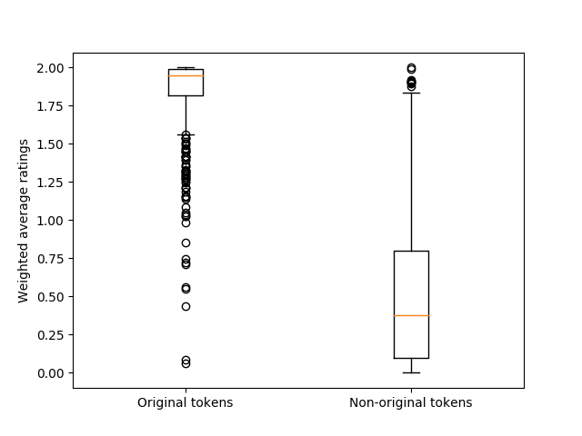

Slide 20
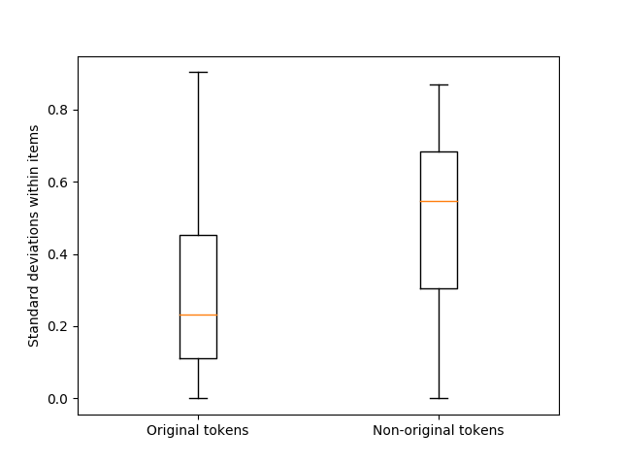

Slide 21
Native Speakers Differ in Their Choices, Especially When Reacting to Non-Authentic Language
This data gives evidence of divergence in the grammars of speakers
Native speakers are more reliable in reacting to authentic language, than in reacting to language that has been manipulated (here, by suggesting an aspectual form that does not match the original text)
This result may also have implications for how much linguists can rely on the intuitions of native speakers in reaction to constructed “examples” as opposed to authentic ones

Slide 22
Conclusions
Contextual triggers listed in grammars co-occur with only 2% of verbs
Native speakers generally agree on the original aspect (81%)
In some contexts native speakers accept both aspects (17%)
Presence vs. absence of “triggers” does not change distribution
Native speakers are more consistent in rating the original aspect
There is a lot of variation!
There are no clear groups in this data!

Slide 23
What’s next:
Corpus data, experiments, and machine learning to ferret out and model the way that native speakers use context to select aspect
Discover differences between contexts where aspect is determined and where it is open to construal
Build effective resources for language learners

Slide 24
Bibliography (and references therein)
“A user-friendly conceptualization of Aspect”, Slavic and East European Journal, vol. 47, no. 2, 2003, pp. 251-281.
“A metaphor in search of a source domain: the categories of Slavic aspect”, Cognitive Linguistics, vol. 15, no. 4, 2004, 471-527.
“A Metaphor for Aspect in Slavic”, Henrik Birnbaum in Memoriam (=International Journal of Slavic Linguistics and Poetics, vol. 44-45, 2002-03; released 2006), 249-60.
“Aspectual clusters of Russian verbs”, Studies in Language 31:3 (2007), 607-648.
“Motion Verbs and the Development of Aspect in Russian”. Scando-Slavica 54 (2008), 179-197.
“Beyond the pair: Aspectual clusters for learners of Russian”, with John J. Korba, Slavic and East European Journal 52:2 (2008), 254-270.
“Semantic Motivations for Aspectual Clusters of Russian Verbs”. In Christina Y. Bethin, ed. American Contributions to the 14th International Congress of Slavists, Ohrid, September 2008. 2008. Bloomington, IN: Slavica Publishers. pp. 181-196.
“Xoxotnul, sxitril: The relationship between semelfactives formed with -nu- and s- in Russian”, with Stephen M. Dickey[1]. Russian Linguistics, 33: 3 (2009), 229-248.
“Prefixed Perfectives from Non-Determined Motion Verbs in Russian”, In: Viktoria Driagina-Hasko and Renee Perelmutter, eds. New Approaches to Slavic verbs of motion (= Studies in Language Companion Series 115). Amsterdam/Philadelphia: John Benjamins, 2010. pp. 125-140.
“Taking Apart Russian RAZ-”, with Tore Nesset. Slavic and East European Journal 54:3 (2010), 476-501.
“Two ways to get out: Radial Category Profiling and the Russian Prefixes vy- and iz-”, with Tore Nesset[1] and Anna Endresen[2]. Zeitschrift für Slawistik 56:4 (2011), 377-402.
“Russian ‘purely aspectual’ prefixes: Not so ‘empty’ after all?”, with Anna Endresen, Julia Kuznetsova, Olga Lyashevskaya, Anastasia Makarova, Tore Nesset, Svetlana Sokolova. Scando-Slavica 58:2 (2012), 231-291.
“Russkie pristavki kak sistema glagol’nyx klassifikatorov”. Voprosy jazykoznanija 6 (2012), 3-47.
“Semantic Profiles of Five Russian Prefixes: po-, s-, za-, na-, pro-”, with Olga Lyashevskaya. 2013. Journal of Slavic Linguistics 21:2, 211-258.
“Is Russian a verb classifier language?” In Gianina Iordăchioaia, Isabelle Roy, Kaori Takamine (eds.) 2013. Categorization and Category Change, 59-86. Cambridge: Cambridge Scholars Publishing.
“Russian Aspectual Types: Croft’s Typology Revised”. In: Miriam Shrager, George Fowler, Steven Franks, and Edna Andrews (eds.). 2015. Studies in Slavic Linguistics and Accentology in Honor of Ronald F. Feldstein, Bloomington, IN: Slavica Publishers, pp. 147-167.
“Predicting Russian Aspect by Frequency Across Genres”, with Hanne M. Eckhoff and Olga Lyashevskaya. Slavic and East European Journal, 2017.

